Slide 1
UML State Machines
Used to model the dynamic behaviour of a process
Can be used to model a high level behaviour of an entire system
Can be used to model the detailed behaviour of a single object
All other possible levels of detail in between these extremes is also possible

Slide 2
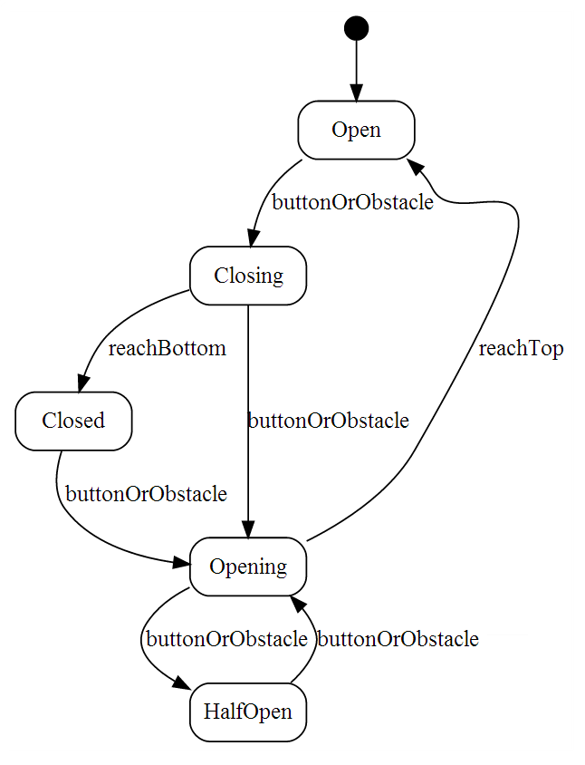
UML State Machine Example
Example of a garage door state machine
(We will come back to this example later)

Slide 3
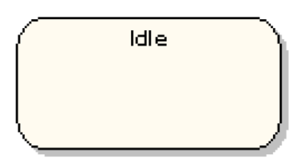
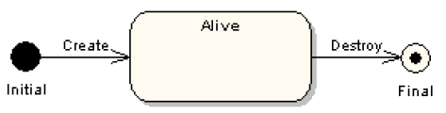
States
State(present attribute value)
Symbol for a state
A system in a state will remain in it until the occurrence of an event that will cause it to transition to another one
Being in a state means that a system will behave in a predetermined way in response to a given event
Symbols for the initial and final states

Slide 4
States
Numerous types of events can cause the system to transition from one state to another
In every state, the system behaves in a different matter
Names for states are usually chosen as:
Adjectives: open, closed, ready…
Present continuous verbs: opening, closing, waiting…

Slide 5
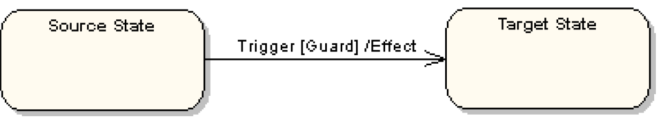
Transitions
Transitions are represented with arrows

Slide 6
Transitions
Transitions represent a change in a state in response to an event
Theoretically, it is supposed to occur in a instantaneous manner (it does not take time to execute)
A transition can have”
Trigger: causes the transition; can be an event of simply the passage of time
Guard: a condition that must evaluate to true for the transition to occur
Effect: an action that will be invoked directly on the system of the object being modeled (if we are modeling an object, the effect would correspond to a specific method)

Slide 7
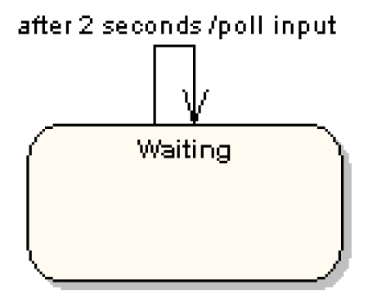
Self Transition
State can also have self transitions
These self transition are more useful when they have an effect associated with them
Timer events are usually popular with self transitions
Below is a typical example:

Slide 8
Coming back to Our Initial Example
Example of a garage door state machine

Slide 9
Decisions
Just like activity diagrams, we can use decisions nodes (although we usually call them decision pseudo-states)
Decision pseudo-states are represented with a diamond
We always have one input transition and multiple outputs
The branch of execution is decided by the guards associated with the transitions coming out of the decision pseudo-state

Slide 10
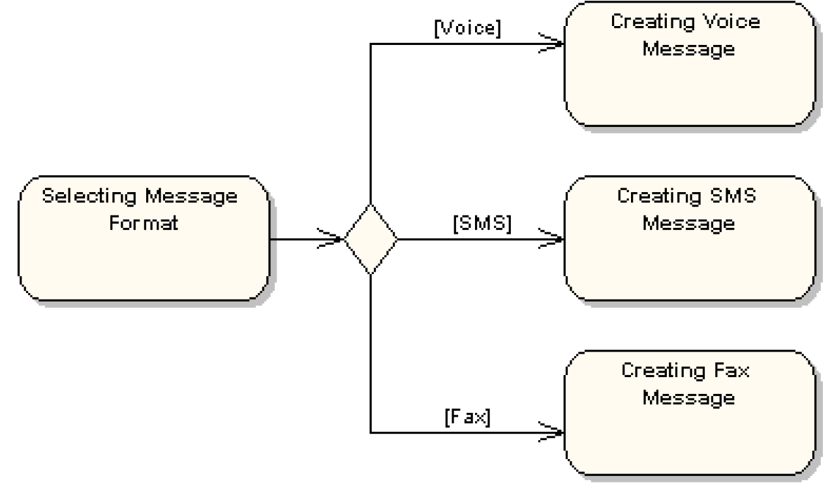
Decisions

Slide 11
Compound States
A state machine can include several sub-machines
Below is an example of a sub-machine included in the compound state “Connected”
Connected
Waiting
disconnect
Disconnected
receiveByte
byteProcessed
ProcessingByte
connect
closeSession

Slide 12
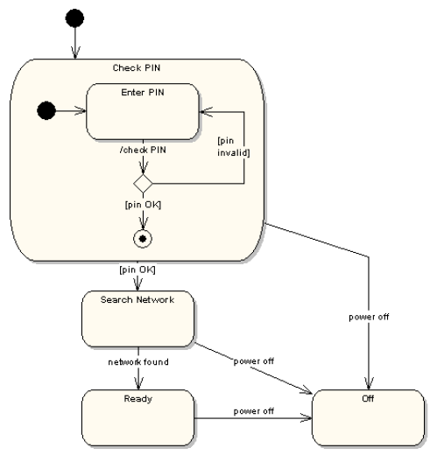
Compound States Example

Slide 13
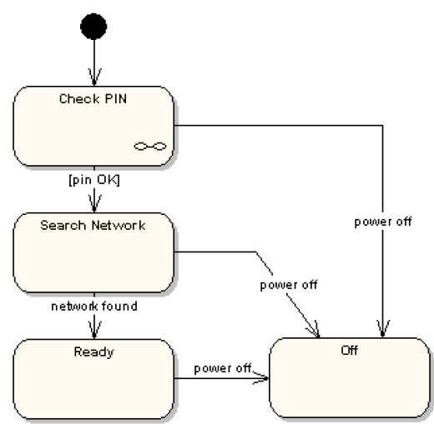
Compound States Example
Same example, with an alternative notation
The link symbol in the “Check Pin” state indicates that the details of the sub-machine associated with “Check Pin” are specified in an another state machine

Slide 14
Use Case – Validate PIN (1)
Use case name: Validate PIN
Summary: System validates customer PIN
Actor: ATM Customer
Precondition: ATM is idle, displaying a Welcome message.

Slide 15
Use Case – Validate PIN (2)
Main sequence:
Customer inserts the ATM card into the card reader.
If system recognizes the card, it reads the card number.
System prompts customer for PIN.
Customer enters PIN.
System checks the card's expiration date and whether the card has been reported as lost or stolen.
If card is valid, system then checks whether the user-entered PIN matches the card PIN maintained by the system.
If PIN numbers match, system checks what accounts are accessible with the ATM card.
System displays customer accounts and prompts customer for transaction type: withdrawal, query, or transfer.

Slide 16
Use Case – Validate PIN (3)
Alternative sequences:
Step 2: If the system does not recognize the card, the system ejects the card.
Step 5: If the system determines that the card date has expired, the system confiscates the card.
Step 5: If the system determines that the card has been reported lost or stolen, the system confiscates the card.
Step 7: If the customer-entered PIN does not match the PIN number for this card, the system re-prompts for the PIN.
Step 7: If the customer enters the incorrect PIN three times, the system confiscates the card.
Steps 4-8: If the customer enters Cancel, the system cancels the transaction and ejects the card.
Postcondition: Customer PIN has been validated.

Slide 17
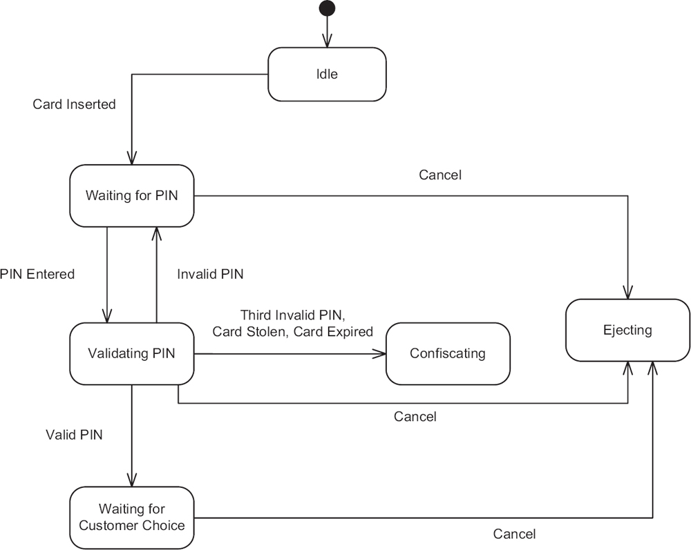
ATM Machine Example
Validate PIN:

Slide 18
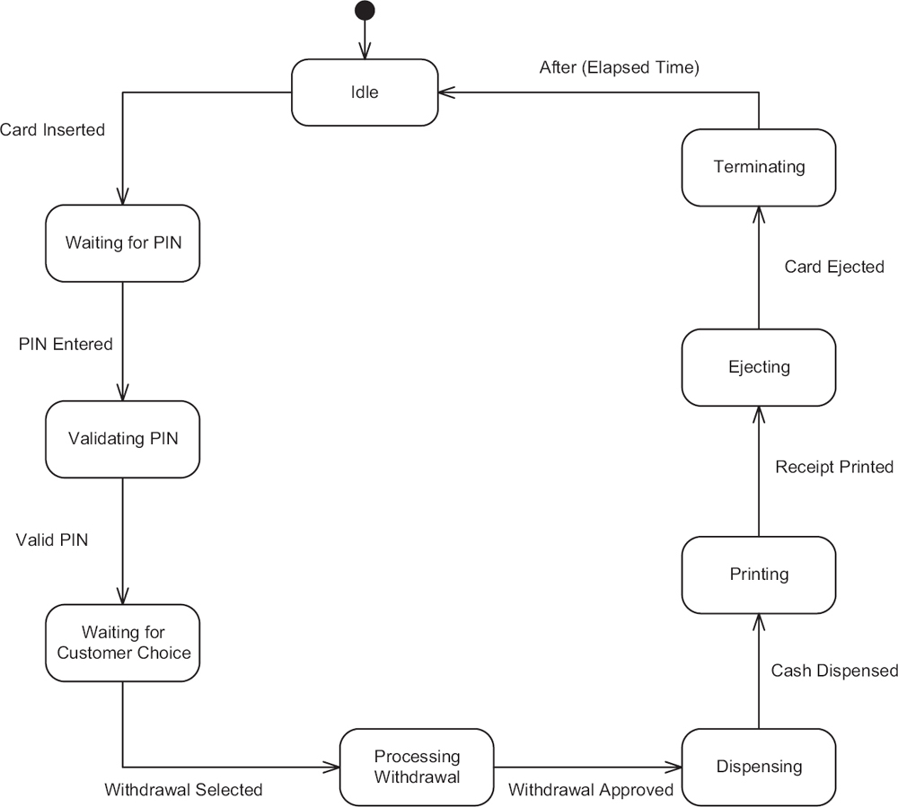
ATM Machine Example
Funds withdrawal:

